Slide 1
Verb Classifiers in Slavic Languages
Laura A. Janda

Slide 2
Overview: The verb classifier hypothesis
Crash Course in Russian aspectual prefixes
Part One: Russian “empty” prefixes
Prefixes in Russian Natural Perfectives are verb classifiers
Part Two: Slavic prefixes as sortal classifiers
Prefixes in Natural and Specialized Perfectives are sortal verb classifiers
Part Three: Mensural classifiers
Prefixes in Complex Act/Aktionsart Perfectives are mensural verb classifiers
Part Four: Typological parallels
Structured polysemy, figure-ground and definiteness effects

Slide 3
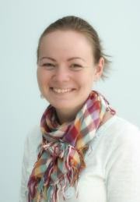



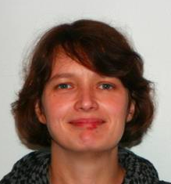
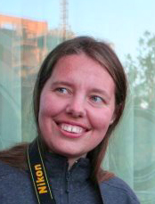
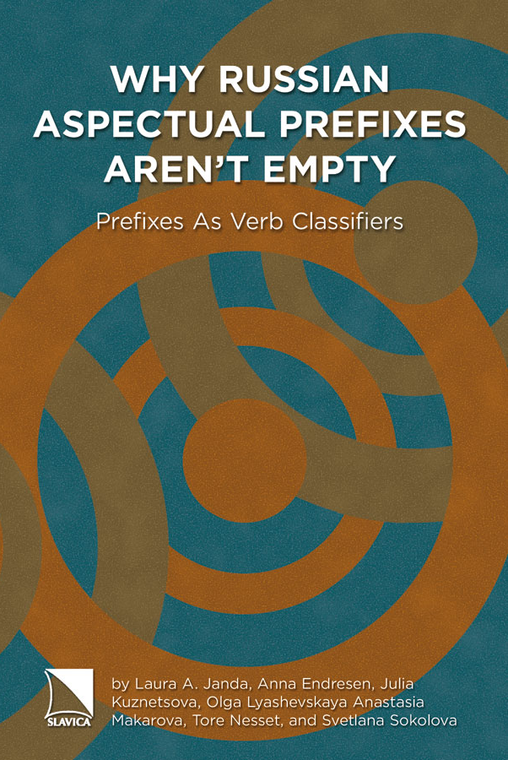
Part One Collaborators and publications
Laura A. Janda, Anna Endresen, Julia Kuznetsova, Olga Lyashevskaya, Anastasia Makarova, Tore Nesset, Svetlana Sokolova. 2013. Why Russian aspectual prefixes aren’t empty: prefixes as verb classifiers. Bloomington, IN: Slavica Publishers.
Laura A. Janda, Anna Endresen, Julia Kuznetsova, Olga Lyashevskaya, Anastasia Makarova, Tore Nesset, Svetlana Sokolova. 2012. “Russian ‘purely aspectual’ prefixes: Not so ‘empty’ after all?” Scando-Slavica 58:2, 231-291.
Laura A. Janda. 2012. Русские приставки как система глагольных классификаторов. Вопросы языкознания 6, 3-47.

Slide 4

Parts 2, 3, and 4 Collaborator and publication
Stephen M. Dickey and Janda, Laura A. 2015. “Slavic Aspectual Prefixes and Numeral Classifiers: Two Kinds of Lexico-Grammatical Unitizers”. Lingua 168, 57-84. DOI: 10.1016/j.lingua.2015.09.005 .

Slide 5
Crash course in Russian aspect

Slide 6
Aspect in Russian
All forms of all verbs express aspect
(residue of biaspectual verbs are syncretic)
Perfective (marked)
Imperfective (unmarked)

Slide 7
Major Patterns of Russian aspectual morphology
Simplex verbs
nearly all Imperfective (delat’ ‘do’)
Prefixed verbs (prefix + simplex)
nearly all Perfective (s-delat’ ‘do’, pere-delat’ ‘redo’)
Prefixed and suffixed verbs (prefix + simplex + suffix)
secondary Imperfectives (pere-del-yva-t’ ‘redo’)

Slide 8
Prefixed verbs (prefix + simplex)
Prefixes on Natural Perfectives termed “empty”
Natural Perfectives: have the “same” meaning as the simplex Imperfective
delat’ ‘do’ -> s-delat’ ‘do’
Specialized Perfectives: change the meaning of the simplex Imperfective
delat’ ‘do’ -> pere-delat’ ‘redo’
Complex Act Perfectives: indicate a certain amoun of an activity
čitat’ ‘read’ -> po-čitat’ ‘read for a while’
Single Act Perfectives:
glupit’ ‘act stupid’ -> s-glupit’ ‘do one stupid thing’
Resultative prefixes associated with SORTAL
classifiers
Procedural prefixes associated with MENSURAL classifiers

Slide 9
17 Perfectivizing prefixes
Prefix | Prototypical path meaning | Related meanings
do‑ | reach | excess, add
iz‑ | out of a container | empty a container, exhaustive result, exhaust a surface, negative exhaustion, make out of, decline/deviate, acquire
na‑ | surface | accumulate
o(b)‑ | around | pass, overdo, mistake, affect many, affect a surface, envelop, impose/acquire a new feature
ot‑ | depart | bounce, unstick, remove, make non-functional, stop at the endpoint
pere‑ | transfer | superiority, overdo, redo, duration/overcome, bridge, turn over, mix, divide, seriatim, thorough
po‑ | set out | result, some, distribute
pod‑ | apply to bottom | horizontal approach, adjust, increment, secretly, minimal
pri‑ | arrive | attach, add, attenuate
pro‑ | through | thorough, duration, distance, pass
raz‑ | apart | crush, spread, swell, soften/dissolve, excitement, un‑
s‑ | down | together, once
u‑ | move away | move downwards, control, reduce, harm, perceive, place/fit, keep/save, cover completely, depart from norm
v‑ | into
v(o)z‑ | move upward | agitate, resist, rebuild
vy‑ | out of a container | empty a container, exhaustive result, exhaust a surface, negative exhaustion, create an image on a surface, make out of, decline/deviate, acquire, endure
za‑ | deflect | excess, begin, exchange, attachment, cover, fill, change to a fixed state

Slide 10
Part One: Russian “empty” prefixes
Prefixes in Russian Natural Perfectives
are verb classifiers

Slide 11
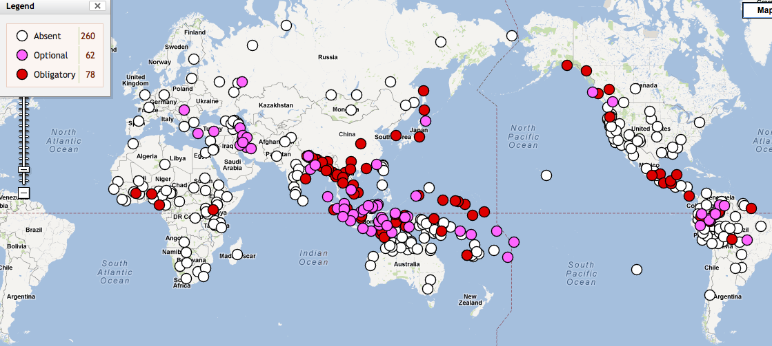
Numeral Classifier Systems Worldwide
Source: The World Atlas of Language Structures Online, wals.info

Slide 12
The function of sortal numeral classifiers
Despite the name, numeral classifiers are noun classifiers
Numeral classifiers are “unitizers” that construe the referents of mass nouns as countable units, i.e., count nouns.
Sortal numeral classifiers “sort” the nouns of the language into groups according to the units that the substances typically form, usually according to their shape, e.g.,
long objects
flat objects
etc.

Slide 13
Yucatec Maya examples of sortal numeral classifiers (Lucy 2000: 329)
‘un-tz’íit kib’ | [one long-thin wax] | ‘one candle’
‘un-tz’íit che’ | [one long-thin wood] | ‘one stick’
‘un-tz’íit nal | [one long-thin corn] | ‘one ear of corn’
‘un-tz’íit há’as | [one long-thin banana] | ‘one fruit of the banana’
‘un-wáal há’as | [one flat banana] | ‘one banana leaf’
‘un-kúul há’as | [one planted banana] | ‘one banana tree’
Numeral classifiers are obligatory in contexts where discrete units are referred to, as in constructions with numerals
Notes:
Linguists at first misunderstood this system. They thought that kib’ meant candle, since that is what it usually means. Then they thought that tz’íit long-thin was an empty, purely formal marker, since candles are long and thin. What linguists did not appreciate at first was that kib’ doesn’t mean candle, it means wax!
And kib’ is representative of Yucatec Maya nouns in general, because nouns in this language refer to substances. From the perspective of Yucatec Maya, the world is an array of substances. The role of classifiers like tz’íit and wáal is to specify various possible units of substances when necessary, like when counting. It is as if the count nouns in English disappeared and were replaced with mass nouns.

Slide 14

Verb Classifier Systems
Linguists have only recently begun to describe verb classifier systems
Verb classifiers have been identified in Chinese and in several Australian languages (McGregor 2002, Gerner 2009)
McGregor (2002) on verb classification: “[d]oubtless it is not confined to the relatively few languages in which it has been hitherto described, though the extent of its distribution across the world’s languages remains to be charted.”

Slide 15
Why Prefixes in Russian Natural Perfectives are Sortal Verb Classifiers
Russian prefixes are “unitizers” that designate discrete events
Russian prefixes are associated with quantification by perfective aspect
Russian prefixes “sort” the verbs of the language according to the parameters of actions; classification by outcome:
expanding with raz- as in puxnut’ > ras-puxnut’ ‘swell’
movement away with y- as in krast’ > u-krast’ ‘steal’
attachment with pri- as in lipnut’ > pri-lipnut’ ‘get stuck to’
Russian prefixes fulfill all distributional criteria for classifiers
overlapping groups are characteristic of classifier systems
the classifiers also “show different behaviours” (McGregor 2002: 17)

Slide 16
How prefixes sort verbs in Russian:
1429 simplex verbs
form 1981 Natural Perfectives
using 16 prefixes
Distribution of prefixes in Russian Natural Perfectives

Slide 17
Comparison of Numeral Classifiers with Aspectual Prefixes
 | Nouns | Verbs
Unitizer Type: | Numeral Classifier | Aspectual Prefix
Quantification: | Associated with numerals | Associated with Perfective Aspect
Spatial Profile: | Bounded/shaped region in space | Trajector-Landmark relation
Etymological Source: | Stem from nouns | Stem from prepositions/particles

Slide 18
Part Two: Slavic prefixes as sortal classifiers
Prefixes in Natural and Specialized Perfectives are sortal verb classifiers

Slide 19
Yucatec Maya examples of sortal numeral classifiers (Lucy 2000: 329)
‘un-tz’íit kib’ | [one long-thin wax] | ‘one candle’
‘un-tz’íit che’ | [one long-thin wood] | ‘one stick’
‘un-tz’íit nal | [one long-thin corn] | ‘one ear of corn’
‘un-tz’íit há’as | [one long-thin banana] | ‘one fruit of the banana’
‘un-wáal há’as | [one flat banana] | ‘one banana leaf’
‘un-kúul há’as | [one planted banana] | ‘one banana tree’
The same classifier can have
different functions with different nouns
Notes:
Linguists at first misunderstood this system. They thought that kib’ meant candle, since that is what it usually means. Then they thought that tz’íit long-thin was an empty, purely formal marker, since candles are long and thin. What linguists did not appreciate at first was that kib’ doesn’t mean candle, it means wax!
And kib’ is representative of Yucatec Maya nouns in general, because nouns in this language refer to substances. From the perspective of Yucatec Maya, the world is an array of substances. The role of classifiers like tz’íit and wáal is to specify various possible units of substances when necessary, like when counting. It is as if the count nouns in English disappeared and were replaced with mass nouns.

Slide 20
A prefix can have different functions with different verbs
Natural Perfectives
puxnut’ ‘swell’ > ras-puxnut’ ‘swell’
krast’ ‘steal’ > u-krast’ ‘steal’
lipnut’ ‘stick’ > pri-lipnut’ ‘stick’
nočevat’ ‘spend the night’ > pere- nočevat’ ‘spend the night’
HIGH DEGREE OF OVERLAP:
Natural Perfectives only change the aspect
Specialized Perfectives
dut’ ‘blow’ >> raz-dut’ ‘inflate’
bežat’ ‘run’ >> u-bežat’ ‘run away’
vjazat’ ‘tie’ >> pri-vjazat’ ‘tie onto’
ždat’ ‘wait’ >> pere- ždat’ ‘wait through something’
LOW DEGREE OF OVERLAP:
Specialized Perfectives change the aspect and the meaning

Slide 21
Natural Perfectives ... Specialized Perfectives
There is no crisp division between Natural Perfectives and Specialized Perfectives
Natural Perfectives are the perfectives for which the meaning of the base verb and the meaning of the prefix overlap most -- the combinations that are the “best match”
Natural Perfectives are also the most frequent -- on average 10x more frequent than Specialized Perfectives
Natural Perfectives
raz-gryzt’ ‘gnaw’
raz-bit’ ‘break’
raz-rezat’ ‘slice’
ras-seč’ ‘cut’
ras-pilit’ ‘saw’
ras-kusit’ ‘bite’
ras-tolkat’ ‘push’
raz-metat’ ‘sweep’
Dictionaries tend
to draw the line here
Specialized Perfectives

Slide 22

Classifier Variation
Some nouns can have several different classifiers: Burmese myiʔ ‘river’ (Becker 1975):
a. myiʔ tǝ myiʔ
river one cl:river
‘a river [default case]’
b. myiʔ tǝ yaʔ
river one cl:place
‘a river as site [for a picnic, etc.]’
c. myiʔ tǝ tan
river one cl:line
‘a river [on a map]’
d. myiʔ tǝ hmwa
river one cl:section
‘a river section [for fishing, etc.]’
e. myiʔ tǝ 'sin
river one cl:distant arc
‘a river as path to the sea’
f. myiʔ tǝ θwe
river one cl:connection
‘a river as a connection [linking villages]’
g. myiʔ tǝ ‘pa
river one cl:sacred object
‘a river [in mythology]’
h. myiʔ tǝ khu’
river one cl:conceptual unit
‘a river [in a discussion of rivers in general]’

Slide 23
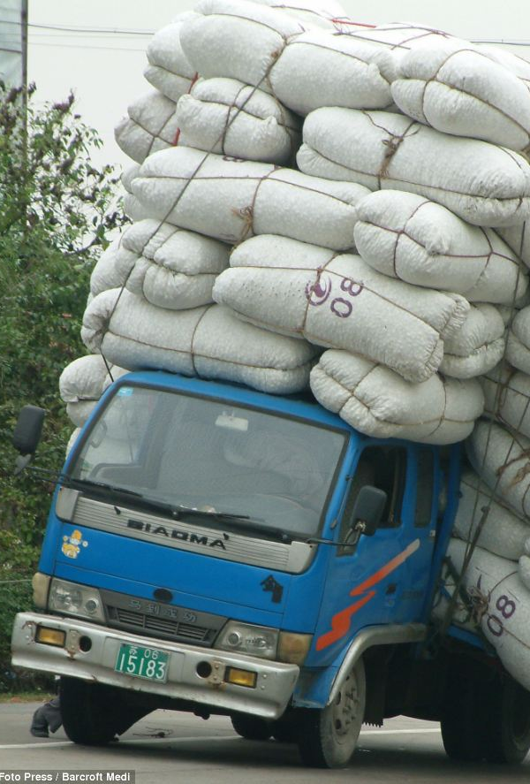
Compare: Prefix Variation Еxample: грузить
Russian gruzit’ ‘load’ has three Natural Perfectives
na-gruzit’ ‘on-load’ focuses on accumulation of loaded objects, e.g., na-gruzit’ sumku arbatskim porodistym tovarom ‘load a bag with fine goods from the Arbat’
po-gruzit’ ‘po-load’ most neutral, can also be used for things that don’t ordinarily get loaded, e.g., po-gruzit’ ranennyx v furgon‘load the wounded into a van’.
za-gruzit’ ‘behind-load’ focuses on states resulting from loading, e.g. za-gruzit’ paroxod proviziej ‘load a steamship with provisions’; default in professional contexts.

Slide 24

Natural and Specialized Perfectives in Other Slavic Languages
Late Common Slavic:
pьsati ‘write’
> na-pьsati ‘write’ Natural Perfective
>> vъ-pьsati ‘write in, insert’ Specialized Perfective
>> za-pьsati ‘record, register’ Specialized Perfective
Czech:
psát
> na-psat
>> ve-psat
>> za-psat
Polish:
pisać
> na-pisać
>> w-pisać
>> za-pisać
BCS:
pisati
> na-pisati
>> u-pisati
>> za-pisati
Bulgarian:
piša
> na-piša
>> v-piša
>> za-piša

Slide 25
Part Three: Mensural classifiers
Prefixes in Complex Act/Aktionsart Perfectives are mensural verb classifiers

Slide 26


Sortal vs. Mensural Classifiers
The Numeral Classifier Construction in Mandarin Chinese
Classifier Type | Numeral | Classifier | Noun
Sortal | yi ‘one’ | tiao cl: long-thin | shengzi rope
Mensural | yi ‘one’ | bei cl: glass | pijiu beer
(Gao & Malt 2009)
Morpho-syntactic behavior is identical
Both types signal units
Sortal: refer to inherent units
Mensural: create units, individuate in terms of quantity
A single classifier can serve both sortal and mensural functions
General classifiers often serve both functions

Slide 27
Sortal vs. Mensural Classifiers for Nouns and Verbs
Unitizer Type: | NOUNS Numeral Classifier | VERBS Aspectual Prefix
Reference to inherent boundaries: | Sortal Classifiers | Lexical + purely perfectivizing prefixes (Natural Perfectives and Specialized Perfectives)
Imposition of external boundaries: | Mensural Classifiers | Procedural prefixes, a.k.a. Superlexical, Aktionsart prefixes (Complex Act Perfectives and Single Act Perfectives)

Slide 28
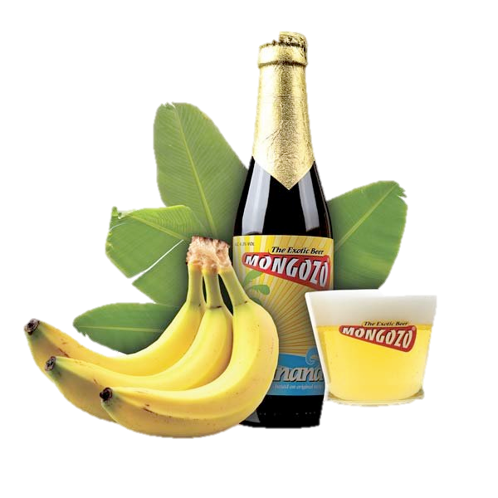

Procedural Prefixes as Mensural Classifiers
(1) a. yi bei pijiu (Mandarin Chinese: Gao and Malt 2009: 1129)
one cl:glass beer
‘a glass of beer’
(1) b. ’um- p’íit há’as (Yucatec Maya; Lucy 1992: 74)
a cl:little-bit/some banana
‘a little bit of/some banana’
(2) a. po- sidet’ (Russian)
for-a-while- sit
‘sit for a while’

Slide 29
A classifier can have different functions with different nouns
If HIGH semantic overlap between classifier and noun => default classifier
If LOW semantic overlap between classifier and noun => other classifier
Mandarin Chinese classifier pian expresses flatness (Zhang 2013: 42):
a. san pian shuye (individual/sortal classifier)
three cl:slice leaf
‘three leaves’
b. yi pian qiche (collective/mensural classifier)
one cl:slice car
‘one group of cars’
c. san pian mutou (individuating/mensural classifier)
three cl:slice wood
‘three pieces of wood’
d. she pian luobo (partitive/mensural classifier)
ten cl:slice carrot
‘ten slices of carrot’
Parallel: prefixes in Natural Perfectives
Parallel: prefixes in Procedural Perfectives

Slide 30
Russian Examples for the Types of Sortal and Mensural Classifiers
Type of Classifier | Russian Perfectivizing Prefixes | Russian Examples
(1) Individual Classifiers (Sortal) | Natural po-, s-, za-, etc. Specialized do-, s-, za-, etc. | po-stroit’ ’build’, s-varit’ ‘cook’, za-krepit’ ‘fasten’ do-pisat’ finish writing’, so-brat’ ‘collect’, za-pisat’ ‘register’
(2) Collective Classifiers (Mensural) | Distributive pere-, po- Cumulative na- | pere-probovat’ ‘try a series of things’, po-brosat’ ‘throw a lot of things’ na-grešit’ ‘commit a lot of sins’
(3) Individuating Classifiers (Mensural) | Delimitative po- Perdurative pro- Attenuative pri-, pod- Ingressive za- Finitive ot- Intensive-Resultative do-…-sja, za-…-sja, etc. | po-sidet’ ‘sit for a while’ pro-plakat’ ‘cry all through a period of time’ pri-tormozit’ ‘tap the brake’, pod-soxnut’ ‘dry a little’ za-govorit’ ‘start to talk’ ot-služit’ ‘complete a tour of duty’ do-pljasat’sja ‘dance one’s feet off’, za-rabotat’sja ‘get lost in one’s work’
(4) Partitive Classifiers (Mensural) | Semelfactive s-, -nu- | s-glupit’ ‘do one stupid thing’, čix-nut‘ ‘sneeze once’

Slide 31
Part Four: Typological parallels
Structured polysemy, figure-ground and definiteness effects

Slide 32
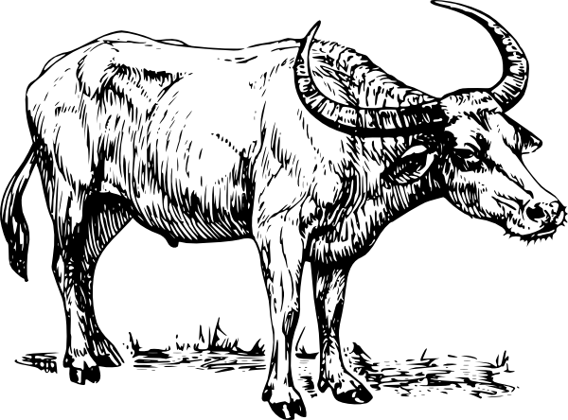
Polysemy and Radial Category Structure for Classifiers
Radial category structure for
Thai Classifier tua
(Deepadung 1997)

Slide 33

Slavic Prefixes in Natural and Specialized Perfectives
Example: Russian raz-
2. CRUSH
raz-davit’
‘crush’
7. UN-
raz-gruzit’
‘unload’
Prototype:
1. APART
raz-bit’
‘break apart’
3. SPREAD
raz-vetvit’sja
‘branch out’
4. SWELL
raz-dut’
‘inflate’
5. DISSOLVE
ras-tajat’
‘melt’
Natural and Specialized Perfectives share
the same radial categories
6. EXCITEMENT
ras-kalit’
‘make red-hot’

Slide 34

Foregrounding Effects of Numeral Classifiers Statistics from Mandarin Chinese (Sun 1988)
In narratives
80% of nouns referring to entities thematically important to narratives (subsequently mentioned) are introduced with a numeral classifier
18% of nouns referring to entities not thematically important to narratives (not subsequently mentioned) are not introduced with a numeral classifier
See examples from myth about the giant Kuafu on next slides...

Slide 35
Foregrounding Effects of Numeral Classifiers Example from Mandarin Chinese (Li 2000: 1121-1122)
Chuan shuo zai hen gu de shihou, you yi-ge jiao Youdu
Legend say be very old mod time, there-be one-cl called Youdu
de defang zhongnian bu jian taiyang, daochu yipian qihei.
mod place all year not see sun, everywhere all pitch dark
Zai nar you yi-zuo da hei shan, shan shang zhu
In there there-be one- cl big dark mountain mountain top live
zhe xuduo kepa de guaishou. Neixie guaishou jingchang xia
pf many scary mod monster. Those monsters often descend
shan weihai renmen. You yi-ge juren jiao Kuafu, ta
mountain endanger people there-be one-cl giant named Kuafu, he
yong guaizhang he guaishou bodou le jiu tian jiu yie zhongyu
use cane with monster fight pf 9 day 9 night finally
ba ta da si le.
ba them beat dead pf
‘Once upon a time, in a place called Youdu, people lived
in darkness all year round. There was a big black mountain
where many terrible beasts lived. The beasts often went out
to harm people. There was a giant called Kuafu. He fought
with the beasts with a stick for nine days and nine nights.
Finally, he killed them all...’

Slide 36
Foregrounding Effects of Numeral Classifiers More Examples from Mandarin Chinese (Li 2000: 1122)
a. Kuafu si le. Tade guanzhang dunshi bian cheng le
Kuafu die PF His walking stick immediately change into PF
yi-ke xianhua shenghai de da taoshu.
one-CL flowers blooming MOD big peach tree
‘Kuafu died. His walking stick immediately changed into a [CL] large peach tree with blooming flowers.’
b. Pangu si hou, tade zhiti bian cheng le shan.
Pangu die after his body change into PF mountain
‘After Pangu died, his body changed into a [Ø] mountain.’
Li: Mandarin Chinese numeral classifiers are employed to mark noun phrases
as salient for the purpose of “vivifying or intensifying the description without
[an] implication of significance in the thematic development of the narrative.”
Example (a) with a numeral classifier presents a relatively vivid image;
example (b) presents a rather flat image.

Slide 37
Foregrounding Effects of Slavic Aspectual Prefixes
Foregrounding is understood in terms of narrative sequencing via main plotline events
Prefixes are associated with perfective aspect, which tends to mark sequenced plotline events
Kogda na-čalas’ pervaja mirovaja vojna, vsja sem’ja u-exala v derevnju Pominovo v Tverskoj oblasti, na rodinu babuški. Dom, gde oni žili, stoit, kstati, do six por. Tam že, v Pominove, otec po-znakomilsja s moej mamoj. Oni po-ženilis’, kogda im bylo po 17 let.
‘When WWI began, the whole family went to the village of Pominovo in the Tver’ region, where my grandmother comes from. The house where they lived is still standing, by the way. It was there in Pominovo where my father met my mother. They got married when they were 17 years old.’

Slide 38
Weak Definiteness Effects of Numeral Classifiers
Bare classifier constructions (lacking numerals) signal specific or definite reference
Hmong example (Li & Bisang 2012: 353)
Thaum ub muaj ob tug niam txiv. Tus txiv tuag lawm.
Long.ago there.are two cl wife husband cl husband die pf
Tus niam quaj quaj nrhiav nrhiav tsis tau tus txiv.
cl wife cry cry look.for look.for neg get cl husband
‘Long ago there was a wife and a husband. The husband died.
The wife kept crying but no matter how she looked, she couldn’t find the/her husband.’
Vietnamese example (Simpson et al. 2011: 185-186)
Thư viện vừa có thêm một kế toán và một luật sư.
library just have add one accountant and one lawyer
Ngời kế toán rất chăm chỉ, nhưng ngời luật sư rất lười.
cl accountant very diligent but cl lawyer very lazy.
‘The library has a new accountant and a new lawyer. The accountant is hard-working, but the lawyer is quite lazy.’

Slide 39

Definiteness Effects of Slavic Prefixes are Strongest in Russian (Leinonen 1982, Dickey 2000)
a. Kto pro-čital Vojnu i mir? (Perfective, presumes there was an expectation)
b. Kto čital Vojnu i mir? (Imperfective)
‘Who read War and Peace?’
а. Ty pro-čital moju knigu? (Perfective)
b. Ty čital moju knigu? (Imperfective, follow up: Ty ne videl tam zapisku?)
‘Did you read my book? (You didn’t see a note there?)’
Perfective sentences reflect shared information, focus on specific event. Imperfective sentences lack this implication.

Slide 40
Conclusions Verb Classifier Hypothesis
Prefixes that form Natural and Specialized Perfectives in Slavic languages parallel sortal numeral classifiers
Prefixes that form Procedural Perfectives in Slavic languages (mainly East Slavic and Bulgarian) parallel mensural numeral classifiers
Shared traits of numeral classifiers and Slavic aspectual prefixes
Overlap produces default classifiers
Variation produces choices among multiple classifiers
Generalized productive classifiers
Radial category structure
Foregrounding, discourse prominence in narrative
Weak definiteness effects
Recognition of Slavic aspectual prefixes as verb classifiers facilitates typological comparison

